Slide 1
String programs of 8086

Slide 2
String instructions:
Prefixes: REP/REPE/REPNE/REPZ/REPNZ
MOVSB/MOVSW
CMPSB/CMPSW
LODSB/LODSW
STOSB/STOSW
SCASB/SCASW
Default source operand : DS:SI, destination: ES:DI
MOV AX,DATA
MOV DS,AX
MOV ES,AX
Direction flag value decides if SI/DI values are to be incremented or decremented after the instruction execution

Slide 4
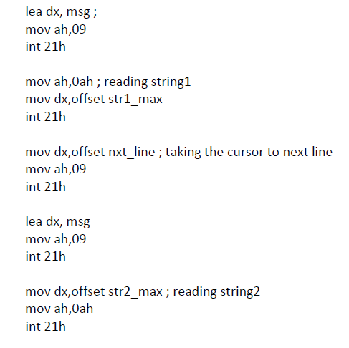
String comparison

Slide 5
String comparison

Slide 6
Modify string comparison program to read a password and validate
Store the actual password as string1
Read password from user as string using MOV AH,08, INT 21H (reads a character without echo) interrupt
Store each character read from keyboard which is present in AL register using STOSB
Display ‘*’ for every entered character.
Compare and display appropriate messages

Slide 7
Program to check if entered string is palindrome
Read the string from the user
Initialise SI to the beginning of the string and DI to the last character
Using cmpsb instruction compare [SI] WITH [DI] as long as they are matching and [SI]<[DI]
Increment SI and decrement DI
Display the message accordingly

Slide 8
Program to insert a substring into a main string
S: main string (ex: abcde$)
len: length of main string (ex: 5)
Len2: length of substring (ex:3)
Substr: substring to be inserted
(ex: xxx$)
POS: position at which substr is to be inserted assuming pos value for first place is 0. (ex:2)
Output is abxxxcde$
; abcdecde$

Slide 9
Thank you

